Slide 1
كشف الأحداث ومراقبتها في وسائل التواصل الاجتماعي اعتمادً على تقنيات التعلم العميق
تقديم: حسن خضور
إشراف: د. رياض سنبل
3/6/2023

Slide 2
Table of Content
Introduction
Work Plan
Completed Stages
System Architecture
Next Step
Event Detection and Monitoring in Social Media

Slide 3
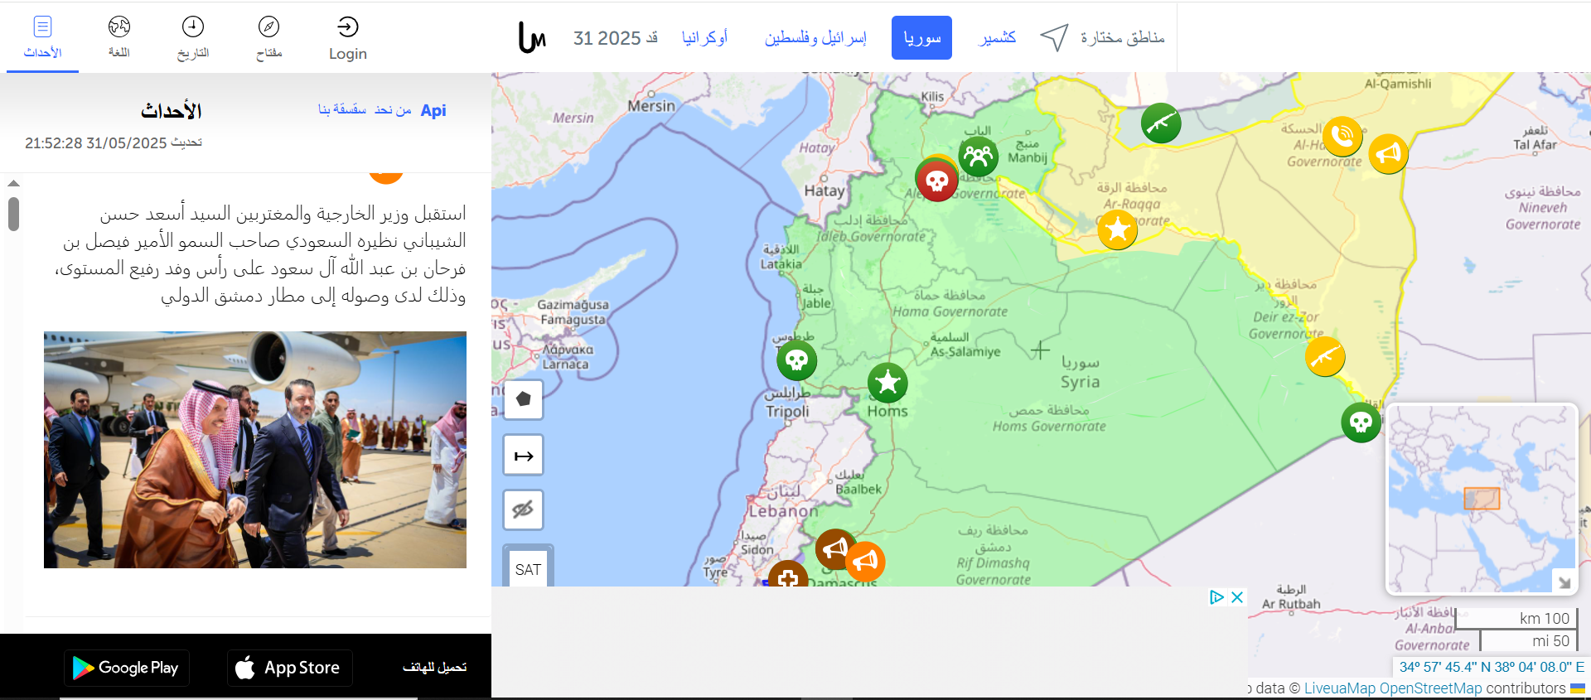
Introduction
[Syria.liveuamap.com]
Event Detection and Monitoring in Social Media

Slide 4
Introduction
What is our Project?
Detect events from Arabic social media posts.
Inspired by Liveuamap, but focused on automated, AI-driven event detection. Displays daily incidents on a map for public and decision-maker awareness.
Why Do We Need This?
Social media is often the first source of real-time event reporting.
No similar system focused on Arabic social media and local events exists.
Event Detection and Monitoring in Social Media

Slide 5
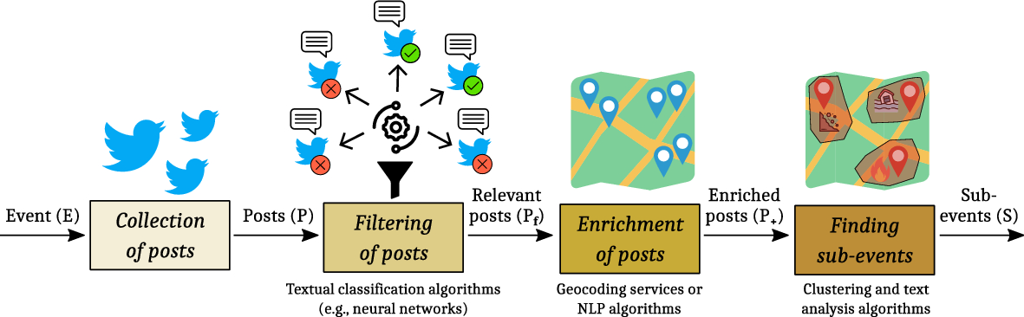
Problem Statement (Academic Perspective)
Location inference
Detect events from data stream
Dealing with large amount of data
an example of how is the general works (Belcastro et al ).
Event Detection and Monitoring in Social Media

Slide 6
Work Plan
Sprints
Milestones
Study Similar Systems
Detection Approaches
Core Sprint (Minimal Viable Project)
Data Collection Sprint
minimal and base lines for AI (current)
Detection and Filtering Approach
Location Inference Approach
Refine the System
Refine the AI Models
Documentation
MVP Release (19 May )
First Release (19 June)
Second Release (15 July )
Production Release (29 July )
Event Detection and Monitoring in Social Media

Slide 7
Completed Stages
What we do in the previous sprints
Implementing first release of the platform
Micro-services solution
Collect real data from twitter
Base lines for the filter model, Detection Model
Explore the related work approaches
Event Detection and Monitoring in Social Media

Slide 8
Completed Stages
Platform First Release
Scraping Management service
Scraping Agent (from telegram)
Location Inferences with LLM
Detection Service (naive)
Events Service
Frontend
Event Detection and Monitoring in Social Media

Slide 9
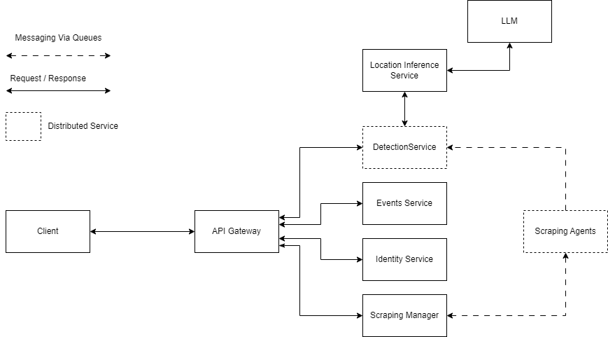
Completed Stages
Event Detection and Monitoring in Social Media

Slide 10
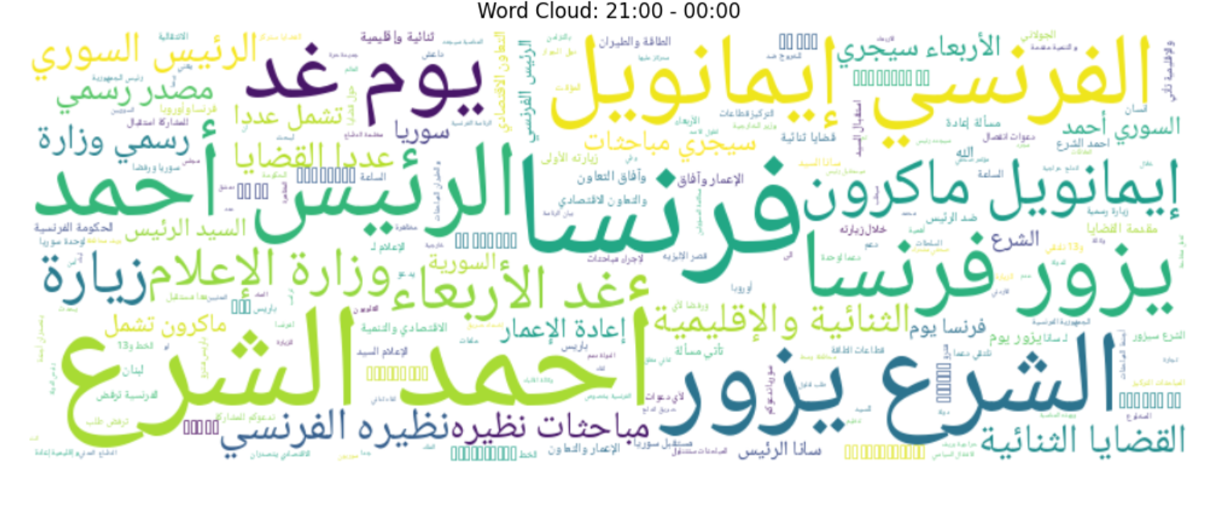
Completed Stages
Collect Real Data from Twitter
~20.000 Tweet
Manual Labeling for 4.000 Tweet
From 1 to 31 May 2025
Belong to 107 Event
Event Detection and Monitoring in Social Media

Slide 11
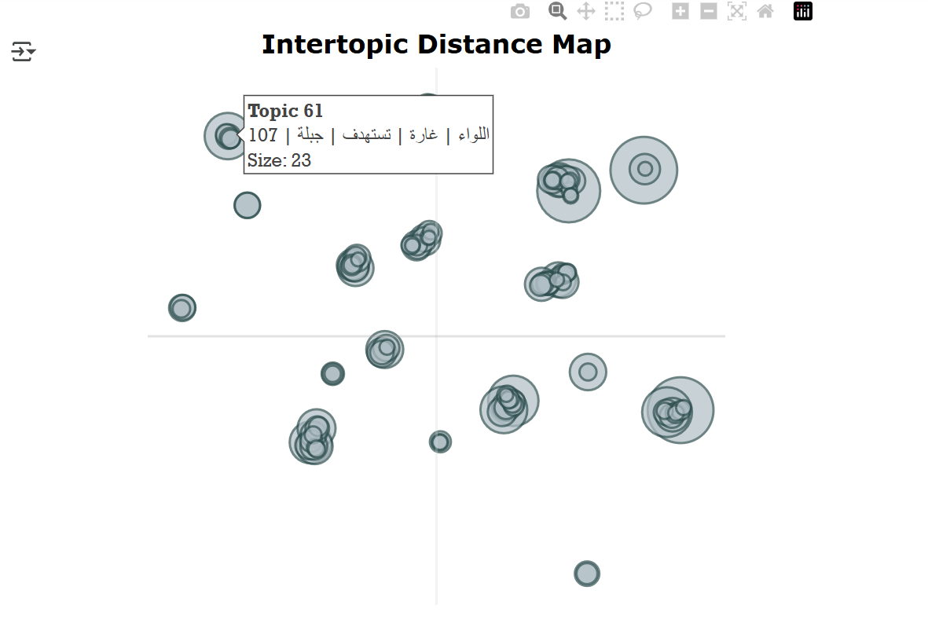
Completed Stages
Base Line Models
For tweet filtering we get a 85% accuracy
For Clustering:
we explore topic modeling approaches
we explore BERTopic as baseline
Event Detection and Monitoring in Social Media

Slide 12
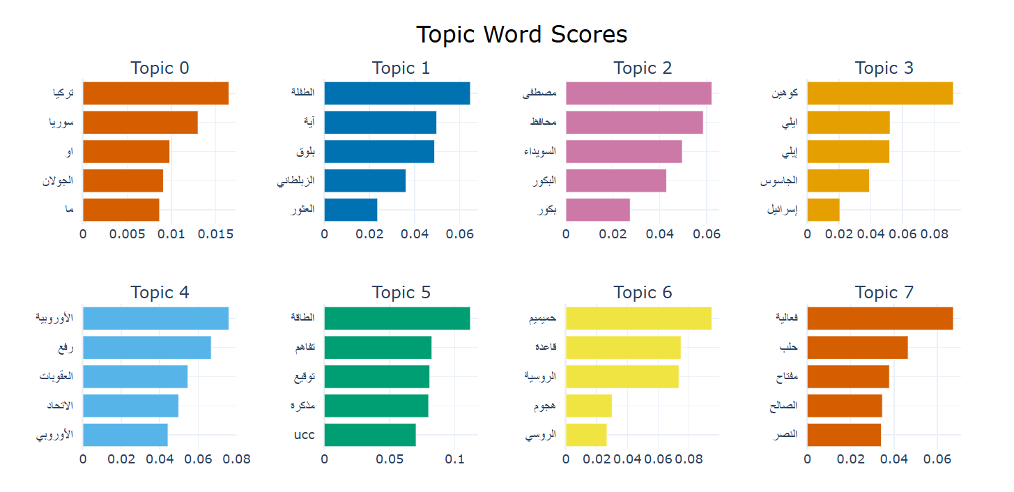
Completed Stages
Base Line Models
Event Detection and Monitoring in Social Media

Slide 13
Next Step
What we will do in the next sprints:
Refine the overall system
Enhance the filtering model
Focus on and Enhance the Detection Approach
Define and Evaluate the Location Inference Approach
Event Detection and Monitoring in Social Media

Slide 14
Thanks!!
Event Detection and Monitoring in Social Media

Slide 15
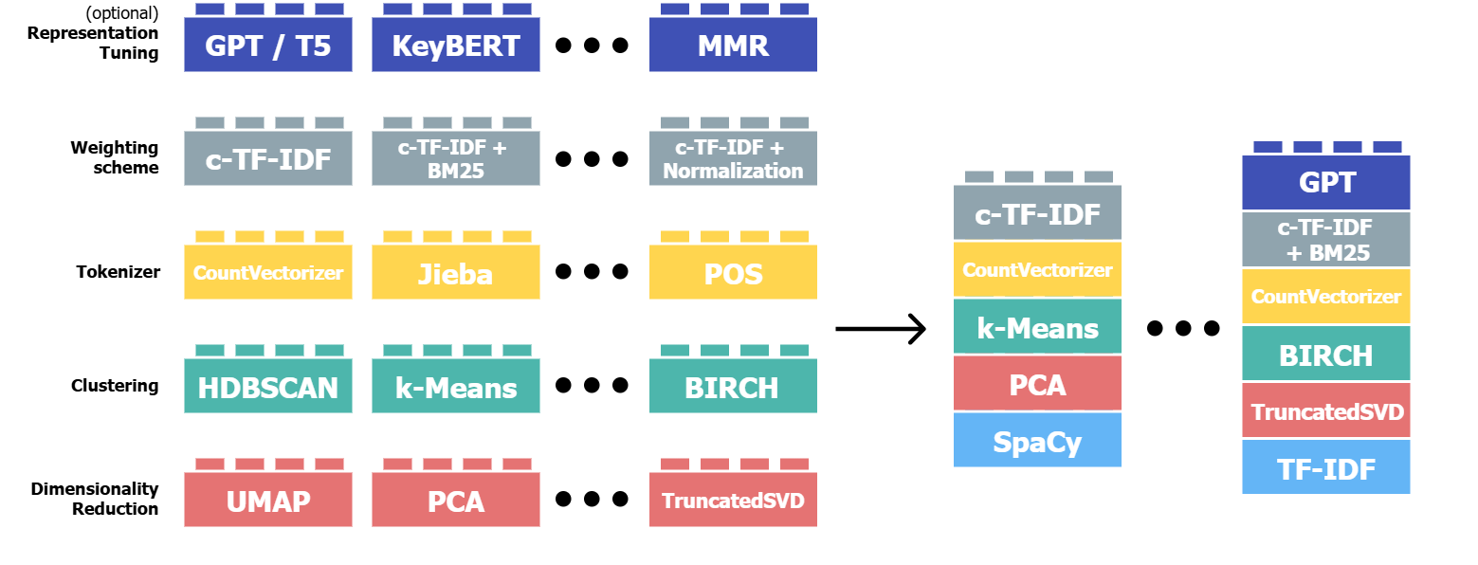
BERTopic
Event Detection and Monitoring in Social Media

Slide 16
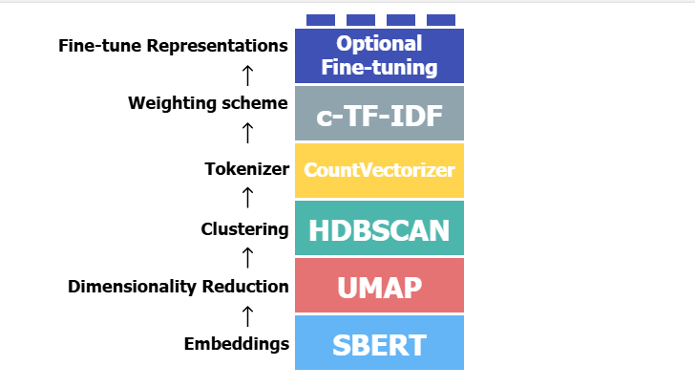
BERTopic
Event Detection and Monitoring in Social Media

Slide 17
